Slide 1

Prepared by Group 5
Project 4
Machine Learning
August 19, 2024

Slide 2



Team Members
Steve Young
Aidan Kelley
Sarah Son Kim

Slide 3
Introduction
Our team aims to uncover patterns in high school student success rate. We’ll examine relationships between class participation and study time, at home support and tutoring, extracurricular activities and finally gender and ethnicity derived from the data. Our dataset has over 2000 rows which makes our sample size optimal for machine learning analysis.

Slide 4



Project Objectives
Analysis Phase
Predictive Phase
Dashboarding
Sklearn Preprocessing package to import StandardScaler
Sklearn Linear package to import Ridge
Sklearn Metrics package to import MS Error
Ridge Regression
Model Training
Predictions
Prediction Clipping
Parental Education
Study Time
Absences
Tutoring
Parental Support
Extracurricular Activities

Slide 5
Analysis Phase
Sklearn Preprocessing package to import StandardScaler
Transform 2000+ rows to improve neural network model by creating standardized features
How?
Sklearn Linear package to import Ridge
L2 Regularization
Ridge regularization
Coefficient Shrinkage
Coefficient stabilizing
Ridge Regularization penalizes large coefficients from overfitting the training data
Sklearn Metrics package to import MS Error
Accuracy Score
Precision Score
Confusion Matrix
Notes:
L2 regularization is fundamental in both linear algebra and machine learning to ensure the models are dtsblr snf generalizable

Slide 6

Predictive Phase
Ridge Regression Model
Fitting the Model
Predictations
Notes:
Alpha parameters control the strength of the regularization in regression model to prevent overfitting. Alpha 10 indicates a strong regularization
X train is the independent variables and Y train is the target variable
Y pred ridge are an array of predicted values for tested data within 2 and 4

Slide 7
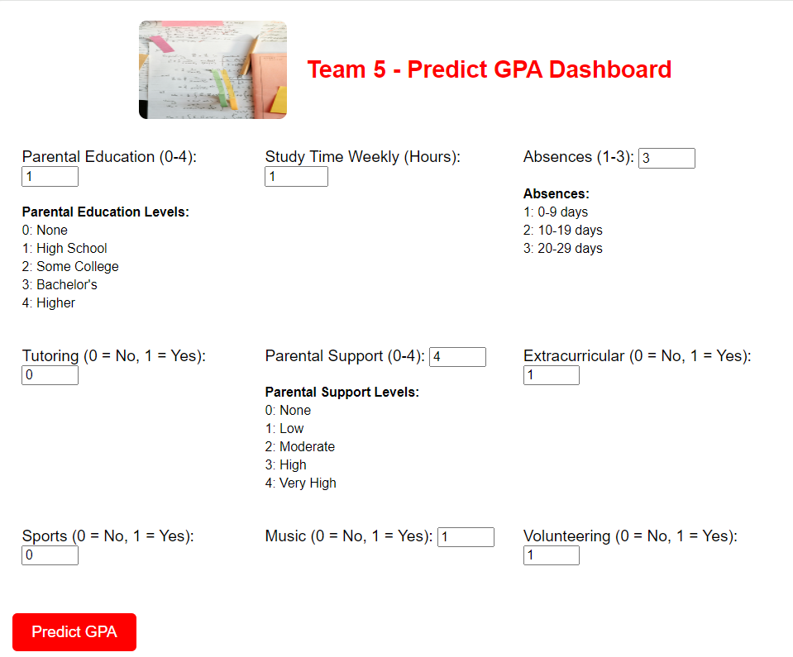
Dashboarding
Parental Education
Study Time
Absences
Parental Support Levels
Tutoring (Boolean)
Extracurricular (Boolean)
Sports (Boolean)
Music(Boolean)
Volunteering (Boolean)

Slide 8
Performance Analysis
Mean Squared Error:
A low MSE indicates that the model’s predictions are close to the actual values. The model has a relatively good fit.
Ridge Regression ME: .0342137
Ridge Regression R² : .8397896
Ridge Regression Coefficients:
Coefficient
R - squared:
ParentalEducation -.004164
StudyTimeWeekly .075879
Tutoring .057121
ParentalSupport .072350
Extracurricular .041709
Sports .046196
Music .024733
Volunteering -.001423
Log_Absences -.413729
83.98% of the variance in the target variable is explained by the model. This indicates a strong relationship between the features and the target variables.
Coefficients:
These coefficients show the impact of each predictor on the predictive GPA
Strongest impacts are
Study Time
Parental Support
Log Absences

Slide 9
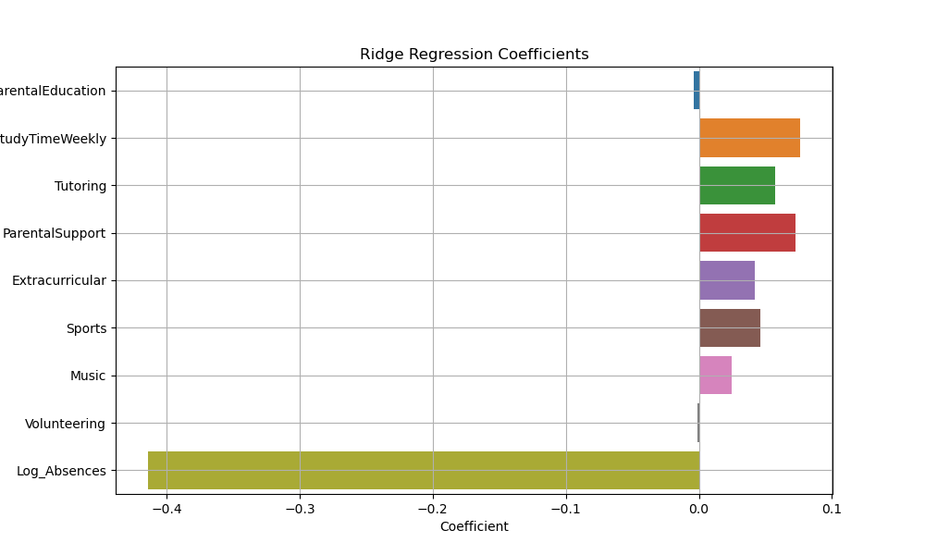
Data Analysis

Slide 10
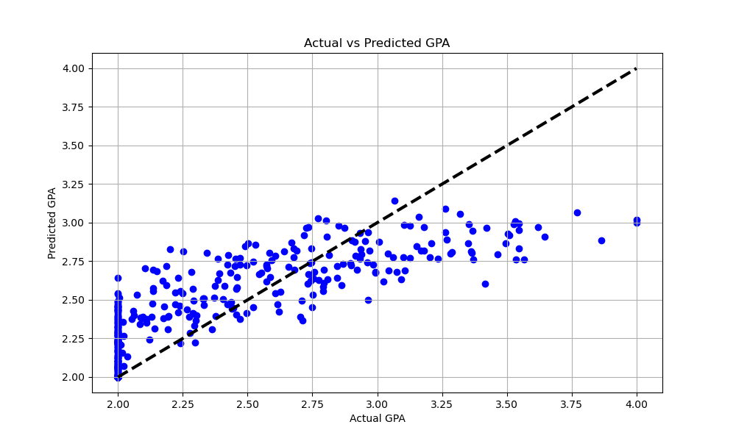
Data Analysis
Actual GPA and Predictive GPA
(+) Linear Regression line indicates a positive relationship with independent variables and the predictive values
Scatter plot trends at a 83% positive relationship indicating a good fit

Slide 11
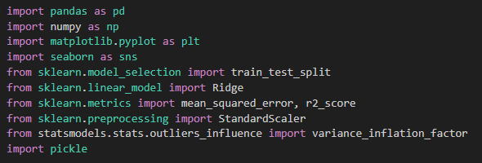
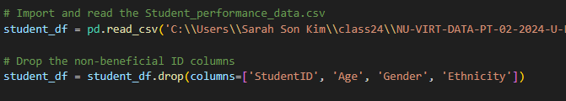
Test-Train Model One
Importing Libraries
Data Import and Initial Processing

Slide 12

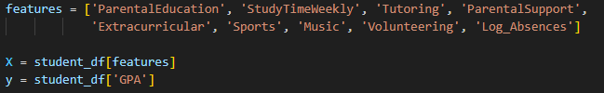
Test-Train Model Two
Feature Engineering
Selecting Features and Target Variable
Clipping the Target Variable
Notes:
Why is this process necessary?
Handling Skewed Data:
Raw Data Distribution: The Absences data might be heavily skewed, with most students having few absences and a few students having many absences. Skewness in data can make it challenging for machine learning models to learn effectively, as the model might become biased toward the majority of the data (students with few absences) and fail to capture the relationship in the tail end (students with many absences).
Log Transformation: By applying a logarithmic transformation, the range of values is compressed, reducing skewness and making the data more normally distributed. This process can improve the performance of models, especially linear models like Ridge Regression, which assume that the input features are normally distributed or at least less skewed.
Reducing the Impact of Outliers:
Outliers in Absences: Students with extremely high numbers of absences (outliers) can disproportionately influence the model, leading to suboptimal predictions.
Effect of Log Transformation: The logarithmic transformation reduces the impact of large outliers by compressing the scale of large values. For example, the difference between 1 and 10 absences is significant, but after log transformation, the difference is much smaller (log(1) ≈ 0, log(10) ≈ 2.3).
Improving Model Performance:
Model Learning: Linear models like Ridge Regression might struggle to capture non-linear relationships in the data. Applying a log transformation introduces non-linearity into the feature, allowing the model to better capture complex relationships between Absences and GPA.
Feature Engineering: Transforming features can sometimes reveal relationships that were previously hidden in the raw data. By applying a log transformation to Absences, the relationship between absences and GPA might become more linear, allowing the model to predict GPA more accurately.
Logarithmic Transformation with np.log1p:
np.log1p Function: The np.log1p function computes log(1 + x) for each value x in the Absences column. This is used instead of np.log(x) to handle cases where x = 0, as the logarithm of zero is undefined. By adding 1 before taking the logarithm, the transformation can be applied to all values, including zero absences.
Practical Implications:
Interpretability: After log transformation, the feature Log_Absences is still interpretable, but it represents a different scale. For instance, a small change in Log_Absences corresponds to a large change in raw absences, reflecting the reduced sensitivity to extreme values.
Model Robustness: The transformation makes the model more robust to extreme cases and improves its ability to generalize across different ranges of absences.
In summary, the log transformation of Absences is a crucial step in preprocessing because it mitigates skewness, reduces the influence of outliers, and helps the model to better capture the relationship between absences and GPA, ultimately leading to more accurate and reliable predictions.

Slide 13


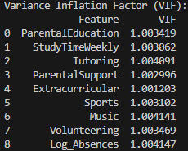
Test-Train Model Three
Scaling the Features
Checking for Multicollinearity
Notes:
Variance Inflation Factor (VIF):
VIF is a measure used to detect multicollinearity in a regression model. Multicollinearity occurs when independent variables (features) in a model are highly correlated with each other. High multicollinearity can make it difficult to estimate the relationship between each feature and the dependent variable.
Interpreting VIF:
A VIF value of 1 indicates no correlation between the feature and any other features (i.e., no multicollinearity).
VIF values between 1 and 5 suggest moderate multicollinearity.
VIF values greater than 5 indicate high multicollinearity, which might require corrective measures.
In your case, all the features have VIF values close to 1, indicating that there is very low or no multicollinearity among the features in your model. This is a good sign as it suggests that the regression coefficients are stable and reliable.

Slide 14

Test-Train Model Four
Train-Test Split
Ridge Regression Model
Predicting and Evaluating the Model
Notes:
Variance Inflation Factor (VIF):
VIF is a measure used to detect multicollinearity in a regression model. Multicollinearity occurs when independent variables (features) in a model are highly correlated with each other. High multicollinearity can make it difficult to estimate the relationship between each feature and the dependent variable.
Interpreting VIF:
A VIF value of 1 indicates no correlation between the feature and any other features (i.e., no multicollinearity).
VIF values between 1 and 5 suggest moderate multicollinearity.
VIF values greater than 5 indicate high multicollinearity, which might require corrective measures.
In your case, all the features have VIF values close to 1, indicating that there is very low or no multicollinearity among the features in your model. This is a good sign as it suggests that the regression coefficients are stable and reliable.
Ridge Regression:
Switched from LinearRegression to Ridge. Ridge regression adds a penalty term to the loss function, which can help prevent extreme predictions and better handle multicollinearity.
Ridge Regression is a type of linear regression that includes a regularization term to prevent overfitting by penalizing large coefficients. This regularization helps the model generalize better on unseen data by introducing a small bias but reducing variance.
Alpha = 10.0: In this specific case, alpha=10.0 indicates a moderate level of regularization. This value has been chosen to strike a balance between bias and variance, aiming to prevent overfitting while still capturing the underlying patterns in the data.

Slide 15
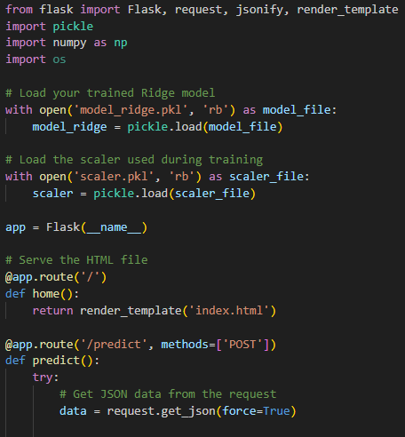
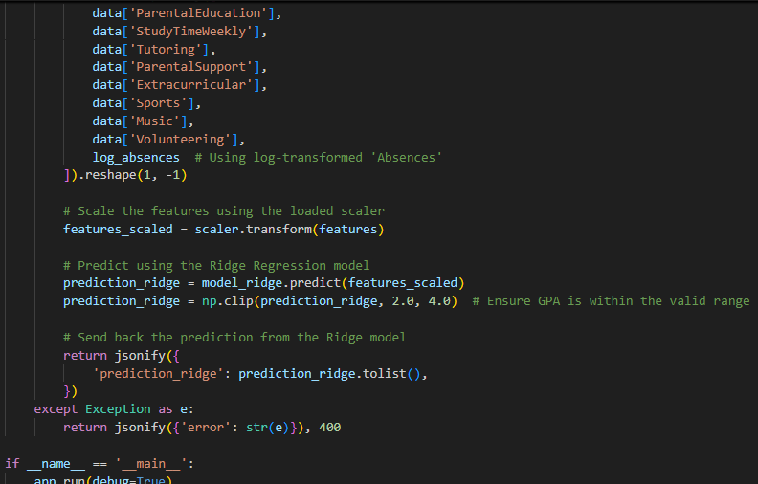
Flask
Notes:
Variance Inflation Factor (VIF):
VIF is a measure used to detect multicollinearity in a regression model. Multicollinearity occurs when independent variables (features) in a model are highly correlated with each other. High multicollinearity can make it difficult to estimate the relationship between each feature and the dependent variable.
Interpreting VIF:
A VIF value of 1 indicates no correlation between the feature and any other features (i.e., no multicollinearity).
VIF values between 1 and 5 suggest moderate multicollinearity.
VIF values greater than 5 indicate high multicollinearity, which might require corrective measures.
In your case, all the features have VIF values close to 1, indicating that there is very low or no multicollinearity among the features in your model. This is a good sign as it suggests that the regression coefficients are stable and reliable.
Ridge Regression:
Switched from LinearRegression to Ridge. Ridge regression adds a penalty term to the loss function, which can help prevent extreme predictions and better handle multicollinearity.
Ridge Regression is a type of linear regression that includes a regularization term to prevent overfitting by penalizing large coefficients. This regularization helps the model generalize better on unseen data by introducing a small bias but reducing variance.
Alpha = 10.0: In this specific case, alpha=10.0 indicates a moderate level of regularization. This value has been chosen to strike a balance between bias and variance, aiming to prevent overfitting while still capturing the underlying patterns in the data.

Slide 16
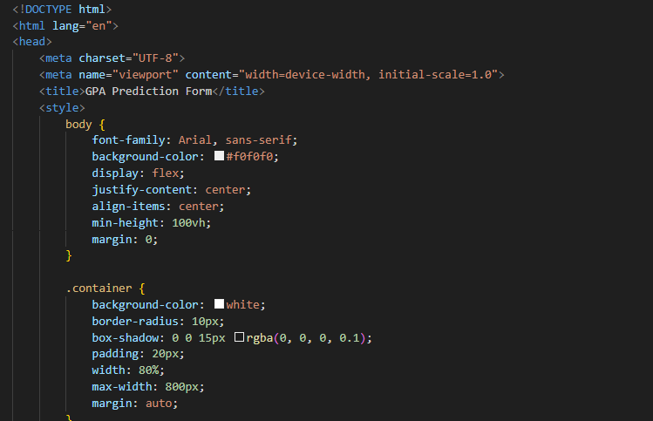
HTML

Slide 17
Conclusion
The Ridge Regression model demonstrates a strong fit with the data, as evidenced by its low MSE and high R². The predictors show minimal multicollinearity, ensuring that each variable contributes uniquely to the model. The positive relationships for most predictors and the significant negative impact of Log_Absences provide valuable insights into factors affecting the outcome. This analysis suggests that interventions targeting increased study time, tutoring, and parental support could positively influence the outcome, while addressing absenteeism could have a substantial beneficial impact.

Slide 18
Thank you

